Slide 1
Chapter 8
MA1506 Mathematics II
Partial Differential equations
PDEs

Slide 2
In this Chapter, we will study
(1)
Method of separation of variables (MSV)
(2)
Solution of wave equation
(Two versions)
(a)By MSV
where
(b) d’Alembert’s method
(3)
Solution of Heat equation
where

Slide 3
Notation
denoted by
denoted by
denoted by
denoted by

Slide 4
Partial Differential Equations
Equations above involving partial derivatives
are called partial differential equations

Slide 5
8.1 SV for PDE
8.1 Separation of variables for PDE N L pp 7-12
In this section, , we study one simple case
by method of separation of variables.
By method of separation of variables, we
assume that solution
can be written as
separation of variables
Hence

Slide 6
8.1 SV for PDE
Example
Use method of S V to
solve
Solution
Let
Then
Hence
holds for any x and y

Slide 7
8.1 SV for PDE
Therefore
for any fixed
Thus
for any fixed k
holds for any x and y
So

Slide 8
8.1 SV for PDE
Solve the above two 1st order ODE, get
Hence

Slide 9





USEFUL FACTS for studying wave and heat equations
USEFUL FACTS
Sturm-Liouville equation
consider
$$X^{″}(x)+λX(x)=0$$
with initial conditions
$$X(0)=0, X^{′}(0)=0$$
Then we know that zero is a solution.
Zero is the only solution.
Now, if we replace the above initial conditions by boundary conditions
$$X(0)=0, X(L)=0$$
Then we have Sturm-Liouville equation
$$X^{″}(x)+λX(x)=0$$
$$X(0)=0, X(L)=0$$

Slide 10

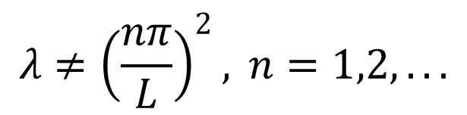


USEFUL FACTS
We shall write down solutions of
Sturm-Liouville equation without proofs.
Case 1
$$λ<0$$
Zero is the only solution
Case 2
$$λ=0$$
Zero is the only solution
Case 3
$$λ>0$$
There are two subcases
$$λ≠{\left(\frac{nπ}{L}\right)}^{2}, n=1,2,...$$
Subcase 1
When
Zero is the only solution

Slide 11
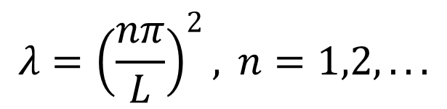
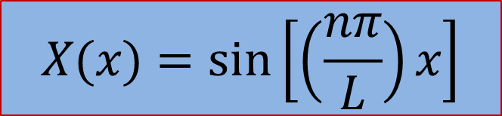
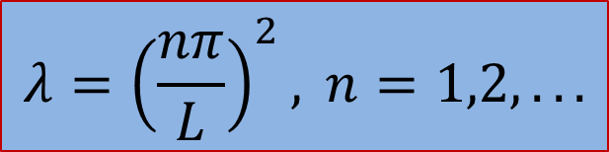
$$λ={\left(\frac{nπ}{L}\right)}^{2}, n=1,2,...$$
USEFUL FACTS
Subcase 2
$$λ={\left(\frac{nπ}{L}\right)}^{2}, n=1,2,...$$
For each
called eigenvalue
there exists nonzero solution
$$X(x)=sin\left[\left(\frac{nπ}{L}\right)x\right]$$
called eigenfunction
This case is very important

Slide 12
Some special integrals
USEFUL FACTS
0
if
1.
1
if
where m, n are positive integers
0
if
2.
1
if
where m, n are positive integers
3.
for any positive
integers m, n

Slide 13
USEFUL FACTS
You don’t have to spend time on working out
Examples 1, 2,3.
Just need to know the results.
Use 1, 2 and 3,
we get
expand

Slide 14
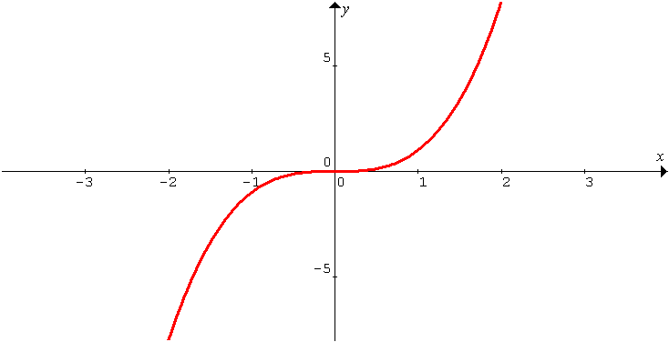
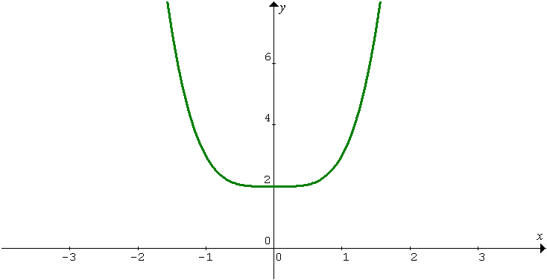
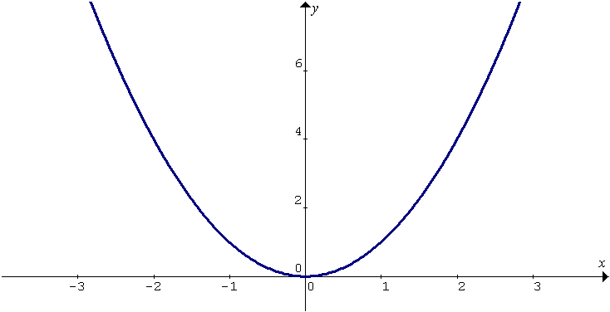


1. Odd function f(x) : symmetric w.r.t. origin
Odd and even functions
USEFUL FACTS
$$\left.f(x)=−f(−x\right)$$
2. Even function f(x): symmetric w.r.t. y-axis
$$\left.f(x)=f(−x\right)$$

Slide 15
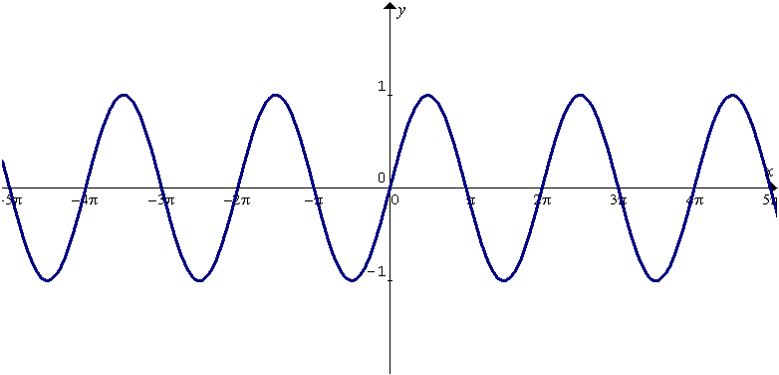
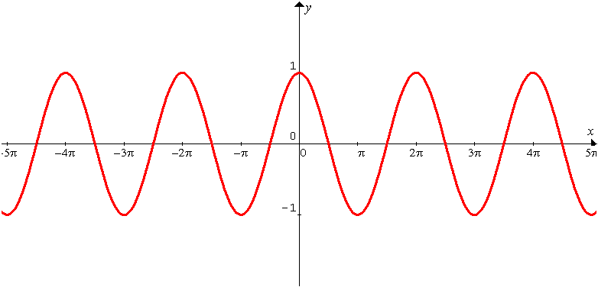
3. sinx, sinαx are odd, where α is any real number
USEFUL FACTS
4. cosx, cosαx are even, where α is any real number

Slide 16
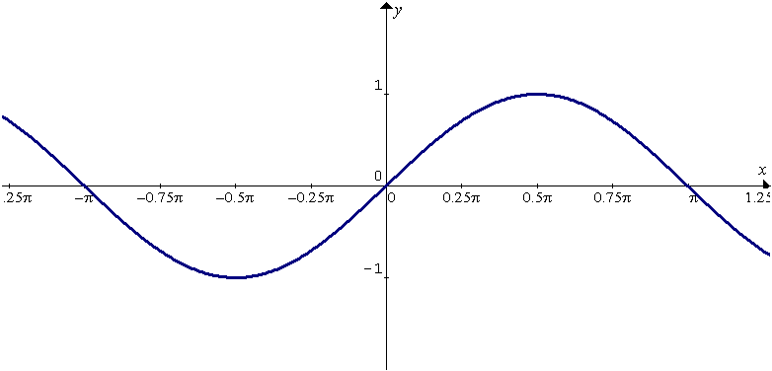
5.
USEFUL FACTS
odd•even=odd function
odd•odd=even function
even•even=even function
•means
multiplication
6.
for any integers n, m
odd
even

Slide 17
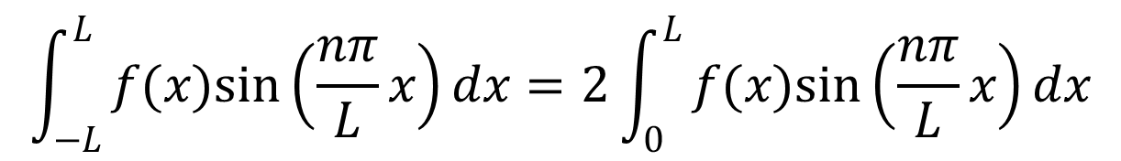
USEFUL FACTS
7.
8.
Let f be odd.
$$\int_{−L}^{L}{f(x)sin\left(\frac{nπ}{L}x\right)}dx=2\int_{0}^{L}{f(x)sin\left(\frac{nπ}{L}x\right)}dx$$
odd
odd

Slide 18
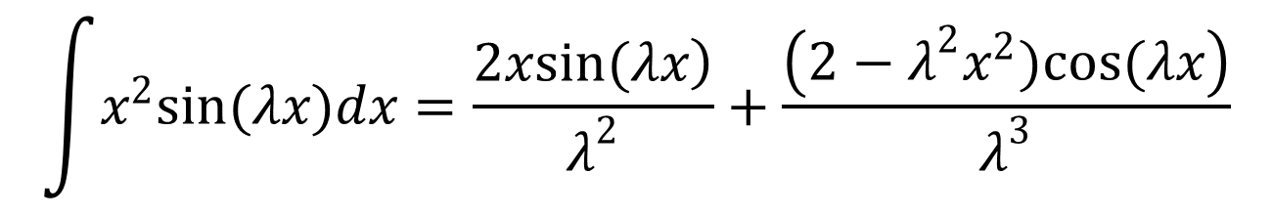
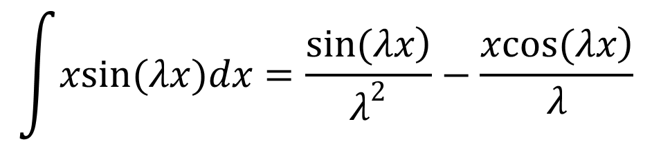
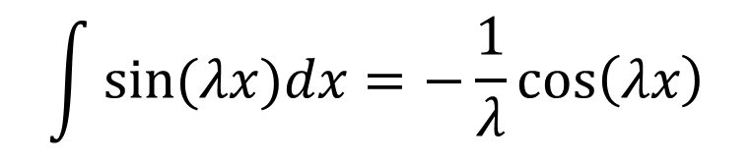
USEFUL FACTS
$$\int{xsin(λx)dx=\frac{\left.sin(λx\right)}{λ^{2}}}−\frac{\left.xcos(λx\right)}{λ}$$
9.
$$\int{x^{2}sin(λx)dx=\frac{\left.2xsin(λx\right)}{λ^{2}}}+\frac{\left(2−λ^{2}x^{2})cos(λx\right)}{λ^{3}}$$
10.
11.
$$\int{sin(λx)dx=−\frac{1}{λ}}cos\left(λx\right)$$

Slide 19
12.

Slide 20
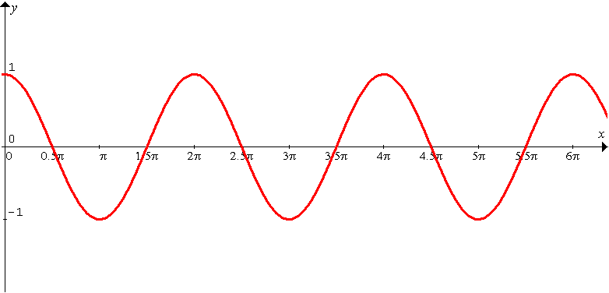
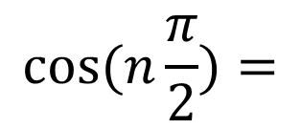
13.
USEFUL FACTS
$$cos(n\frac{π}{2})=$$

Slide 21
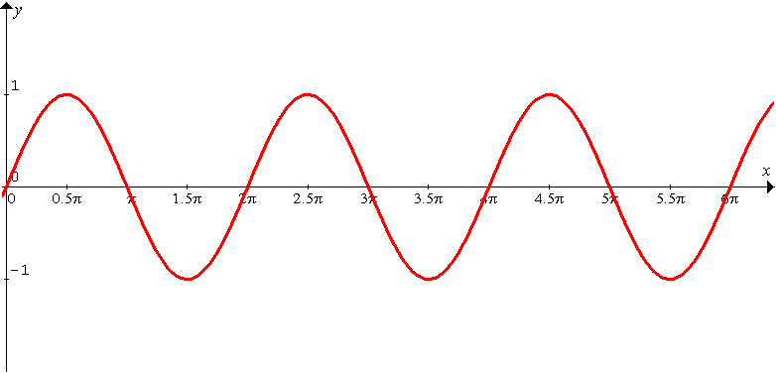
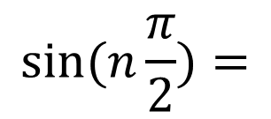
14.
USEFUL FACTS
$$sin(n\frac{π}{2})=$$

Slide 22
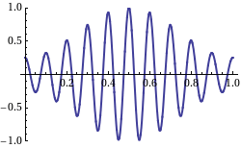
8.2 wave equation
8.2 Wave Equation
Animation slide
Elastic string of length L
tightly stretched
fixed at the end points
The string is set in motion.
It vibrates in vertical plane.

Slide 23
Let be vertical displacement at pt , at time
8.2 wave equation
Let
be constant velocity of propagation
of wave along string
Animation slide
x

Slide 24
8.2 wave equation
We have
where
with boundary conditions:
with initial conditions:
Initial position
Initial velocity

Slide 25
8.2 wave equation
Now we shall use the method of S V
to solve the above wave equation
Solution
By MSV, let
Then
Hence
implies

Slide 26
8.2 wave equation
Therefore
holds for
ALL x, and t
So
for any fixed λ
For convenience, we use -λ
Hence

Slide 27
8.2 wave equation
Now we shall solve
with boundary conditions:
i.e.,
i.e.,

Slide 28
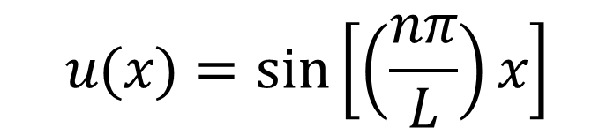
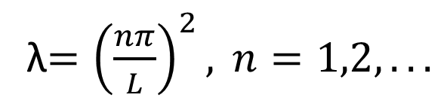
8.2 wave equation
So now we solve
with boundary conditions:
Recall the above equation is
Sturm-Liouville equation.
λ$={\left(\frac{nπ}{L}\right)}^{2}, n=1,2,...$
When
there exists nonzero solution
$$u(x)=sin\left[\left(\frac{nπ}{L}\right)x\right]$$

Slide 29
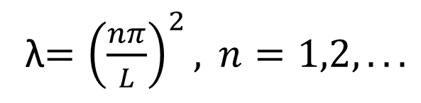
8.2 wave equation
For
λ$={\left(\frac{nπ}{L}\right)}^{2}, n=1,2,...$
now look at corresponding
The general solution is
However, from one of the initial conditions
i.e.,
we have

Slide 30
8.2 wave equation
So for each n,
is a solution of the given PDE
with boundary conditions and initial condition
Hence
is again a solution

Slide 31
8.2 wave equation
In fact
is the general solution of the given PDE
Now we shall use the 2nd initial condition
to find the value of

Slide 32
8.2 wave equation
How to find
First note that
is an odd function define on (-L, L). Now we extend
f defined on (-L,L) s.t. f is odd

Slide 33
8.2 wave equation
Hence we have

Slide 34
Now we shall give one example to show how to shorten the presentation
8.2 wave equation

Slide 35
8.2 wave equation
Example 1
Solve the following wave equation
with boundary conditions:
with initial conditions:
Solution
By MSV, let

Slide 36

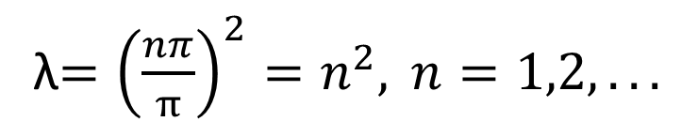
8.2 wave equation
Then we get
Now we solve
with boundary conditions:
λ$={\left(\frac{nπ}{π}\right)}^{2}=n^{2}, n=1,2,...$
When
there exists nonzero solution
$$u(x)=sin(nx)$$

Slide 37
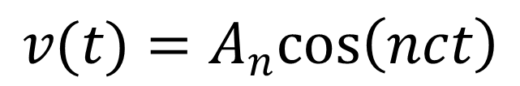
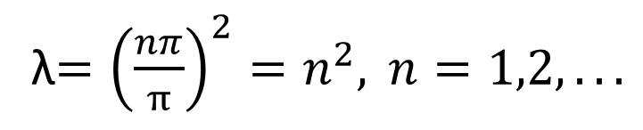
8.2 wave equation
For
λ$={\left(\frac{nπ}{π}\right)}^{2}=n^{2}, n=1,2,...$
now look at corresponding
with initial condition
The general solution is
$$v(t)=A_{n}cos\left(nct\right)$$

Slide 38
8.2 wave equation
Then
is the general solution of the given PDE
Now we shall use the 2nd initial condition
to find the value of

Slide 39
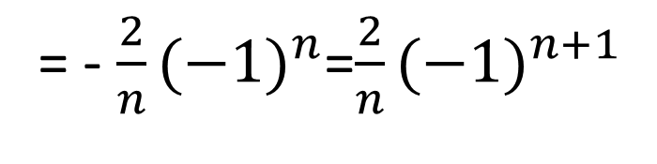
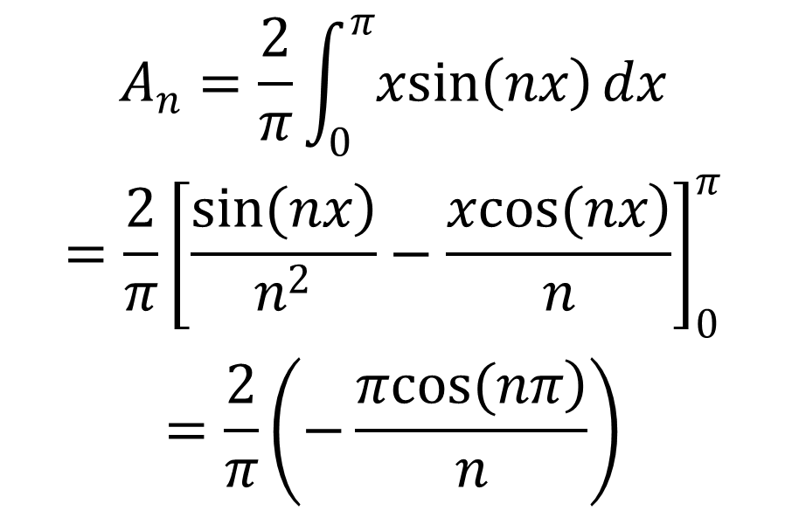
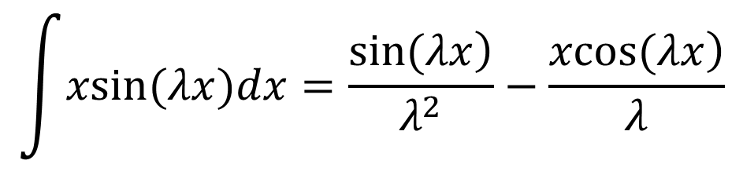
8.2 wave equation
$$\int{xsin(λx)dx=\frac{\left.sin(λx\right)}{λ^{2}}}−\frac{\left.xcos(λx\right)}{λ}$$
Use formula
$$\begin{matrix}A_{n}=\frac{2}{π}\int_{0}^{π}{xsin\left(nx\right)}dx \\ =\frac{2}{π}{\left[\frac{\left.sin(nx\right)}{n^{2}}−\frac{\left.xcos(nx\right)}{n}\right]}_{0}^{π} \\ =\frac{2}{π}\left(−\frac{\left.πcos(nπ\right)}{n}\right)\end{matrix}$$
= - $\frac{2}{n}{(−1)}^{n}$=$\frac{2}{n}{(−1)}^{n+1}$

Slide 40
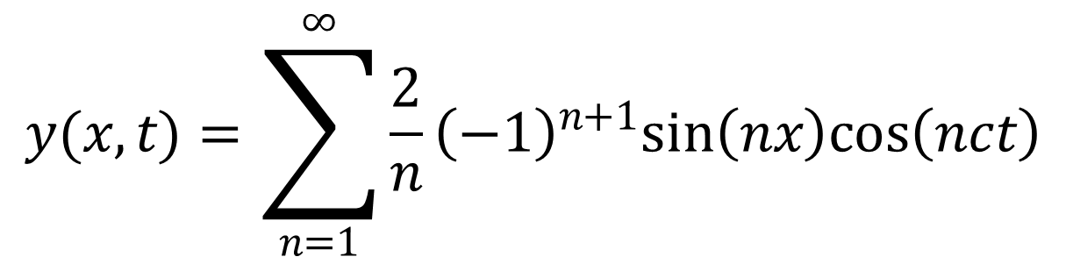
8.2 wave equation
$$y(x,t)=\sum_{n=1}^{∞}{\frac{2}{n}{\left(−1\right)}^{n+1}sin\left(nx\right)cos\left(nct\right)}$$
is the solution of wave equation
with boundary conditions:
and initial conditions:

Slide 41
Summary
8.2 wave equation
Solution of wave equation

Slide 42
8.2 wave equation
Example 2
Solve the following wave equation
with boundary conditions:
with initial conditions:
Solution

Slide 43
8.2 wave equation
where
odd
odd
Hence
Or we can get the above result
by comparing the coefficients
See next slide

Slide 44
8.2 wave equation
Hence
So

Slide 45
8.2 wave equation
d’Alembert’s solution of the wave equation
with boundary conditions:
with initial conditions:
Then solution (given by d’Alembert) is
See Appendix and tutorial 11

Slide 46
Revisit Example 2
8.2 wave equation
Solve the following wave equation
by d’Alembert’s solution
with boundary conditions:
with initial conditions:

Slide 47
The solution (given by d’Alembert) is
In this Example 2 ,
Hence
Recall by MSV, the solution is
These two solutions are equivalent which can be proved by the following formula

Slide 48
8.3 Heat Equation
Heat-conducting rod with length L
0
L
represents temperature at point x,
at time t
Let
be thermal diffusivity
We have

Slide 49
8.3 Heat Equation
with boundary conditions:
0
0
Temperatures are always ZERO at both end points
with initial condition:
Initial distribution of temperature given by f(x)

Slide 50
8.3 Heat equation
Now we shall use the method of S V
to solve the above heat equation
Solution
By MSV, let
Then
Hence
implies

Slide 51
8.3 Heat Equation
Therefore
holds for
ALL x, and t
So
for any fixed λ
For convenience, we use -λ
Hence

Slide 52
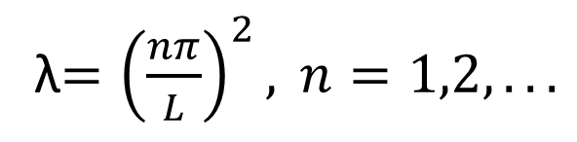
8.3 Heat Equation
Now we shall solve
with boundary conditions:
Recall the above equation is
Sturm-Liouville equation.
When
λ$={\left(\frac{nπ}{L}\right)}^{2}, n=1,2,...$
there exists nonzero solution

Slide 53
8.3 Heat Equation
For
λ$={\left(\frac{nπ}{L}\right)}^{2}, n=1,2,...$
now look at corresponding
A solution is

Slide 54
8.3 Heat Equation
So for each n,
is a solution of the given heat equation
with boundary conditions
Hence
is again a solution

Slide 55
8.3 Heat Equation
In fact
is the general solution of the given PDE
Now we shall use the initial condition
to find the value of

Slide 56
8.3 Heat Equation
How to find
First note that
is an odd function define on (-L, L). Now we extend
f defined on (-L,L) s.t. f is odd

Slide 57
8.3 Heat Equation
Hence we have

Slide 58
Heat Equation
Summary
Solution of Heat equation

Slide 59
8.3 Heat Equation
Example 1
Suppose

Slide 60
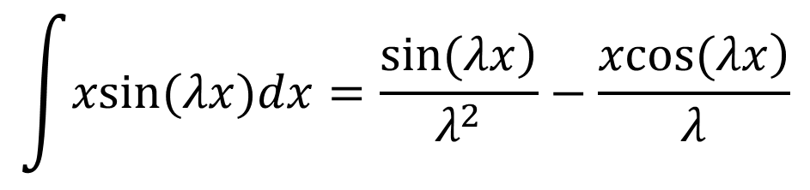
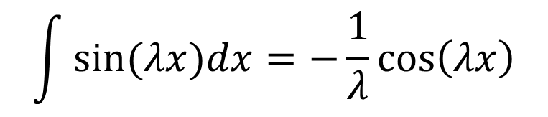
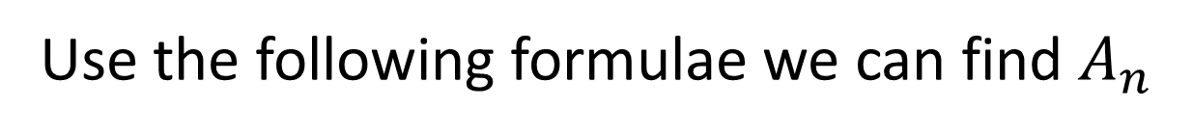
8.3 Heat Equation
Use the following formulae we can find $A_{n}$
$$\int{xsin(λx)dx=\frac{\left.sin(λx\right)}{λ^{2}}}−\frac{\left.xcos(λx\right)}{λ}$$
$$\int{sin(λx)dx=−\frac{1}{λ}}cos\left(λx\right)$$

Slide 61




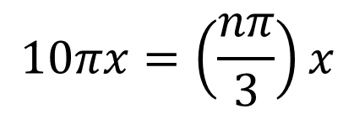
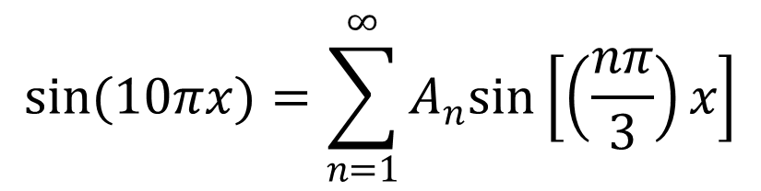
Example 2
Suppose
$$\left.L=3, f(x)=sin(10πx\right)$$
Now find
$$A_{n}$$
We shall compare coeff.
$$sin(10πx)=\sum_{n=1}^{∞}{A_{n}sin\left[\left(\frac{nπ}{3}\right)x\right]}$$
Note that if
$$10πx=\left(\frac{nπ}{3}\right)x$$
then
$$n=30$$
So
$$A_{30}=1, A_{n}=0, if n≠30$$

Slide 62
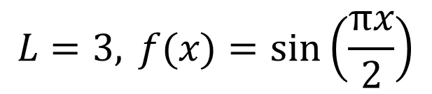
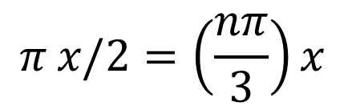
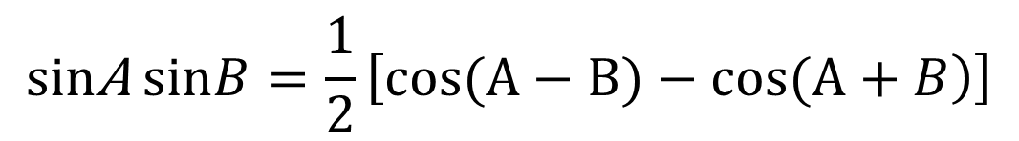
Example 3
$$L=3, f(x)=sin\left(\frac{πx}{2}\right)$$
Suppose
Now find
$$A_{n}$$
We can’t compare coeff., since we can’t find
positive integer n such that
$$π x/2=\left(\frac{nπ}{3}\right)x$$
So use
Use the following formula to evaluate the above integral
$$sin\text{A} sinB=\frac{1}{2}\left[\left.cos(A−B)−cos(A+B\right)\right]$$
End
Chapter 8

Slide 63
Appendix
Order of PDE
1st order PDE
2nd order PDE

Slide 64
Homogeneous PDE
The following are homogeneous PDE

Slide 65
Nonhomogeneous PDE
The following are nonhomogeneous PDE

Slide 66
Linear PDE
The following homogeneous PDE are
called linear PDE
Since for each of the above PDEs, if v and w are
solutions, then we can check that
is again a solution

Slide 67
The following nonhomogeneous PDE are
called linear PDE
since the corresponding homogeneous PDE is linear

Slide 68
Remarks on d’Alembert’s solution
In discussion of wave equations, we have
By formula
$$sin\left[\left(\frac{nπ}{L}\right)x\right]cos\left[\left(\frac{nπ}{L}c\right)t\right]=\frac{1}{2}\left[sin\left[\left.\left(\frac{nπ}{L}\right)(x+ct\right)\right]+sin\left[\left.\left(\frac{nπ}{L}\right)(x−ct\right)\right]\right]$$
Hence
Note that the original f is defined on [0,L]. First we need to extend f to be defined on [-L,L] such that f is odd. Secondly, we need to extend f to be defined on the whole real line by assuming f is 2L periodic. Hence f(x+ct), f(x-ct) are well defined

Slide 69
Remarks on d’Alembert’s solution cont.
End
Chapter 8

